Slide 1
Shortest Paths Problem
A
5
3
B
1
C
2
4
D
How can we find the shortest paths from A to every vertex using linear programming?

Slide 2
Shortest Paths Problem
A
max: A + B + C + D;
A = 0;
B <= A + 5;
B <= C + 1;
C <= A + 3;
C <= D + 4;
D <= B + 2;
5
3
B
1
C
2
4
D
Solution: 13
A = 0
B = 4
C = 3
D = 6
Let A = minimum distance from A to A
Let B = minimum distance from A to B
Let C = minimum distance from A to C
Let D = minimum distance from A to D

Slide 3
Example Linear Program
Chocolate company has two products, Matin and Nuit. Here is the issue they face:
They can sell x₁ boxes of Matin for a profit of $1 per box.
They can sell x₂ boxes of Nuit for a profit of $6 per box.
They can sell at most 200 boxes of Matin and 300 of Nuit per day.
They can produce at most 400 total boxes per day.
What should they do to maximize profit?
We can express all this with a linear program:
Objective function:
Maximize x₁ + 6x₂
Constraints:
x₁ ≥ 0
x₂ ≥ 0
x₁ ≤ 200
x₂ ≤ 300
x₁ + x₂ ≤ 400
Solution:
x₁ = 100 x₂ = 300 max = 1900

Slide 4
Verification
It is easy to check that
The values for x and y satisfy the constraints
The profit corresponds to x and y
But how can we verify that the profit found is optimal?
Linear combinations of the constraints provide upper bounds on objective
1(x₁ ≤ 200) + 6(x₂ ≤ 300) = x₁ +6x₂ ≤ 2000
5(x₂ ≤ 300) + 1(x₁+x₂ ≤ 400) = x₁ +6x₂ ≤ 1900
This last constraint implies that the 1900 profit is optimal.
Objective function:
Maximize x₁ + 6x₂
Constraints:
x₁ ≥ 0
x₂ ≥ 0
x₁ ≤ 200
x₂ ≤ 300
x₁ + x₂ ≤ 400
Solution:
x₁ = 100 x₂ = 300 max = 1900

Slide 5
Duality
Can we automatically derive an upper bound that establishes optimality?
1(x₁ ≤ 200) + 6(x₂ ≤ 300) = x₁ +6x₂ ≤ 2000
5(x₂ ≤ 300) + 1(x₁+x₂ ≤ 400) = x₁ +6x₂ ≤ 1900
Do this symbolically:
y₁ (x₁ ≤ 200) + y₂(x₂ ≤ 300) + y₃(x₁+x₂ ≤ 400) = (y₁+y₃) x₁ + (y₂+y₃) x₂ ≤ 200 y₁ + 300 y₂ + 400 y₃
We need to find y₁ ≥ 0, y₂ ≥ 0, y₃ ≥ 0, y₁+y₃ = 1, y₂+y₃ = 6 so that 200 y₁ + 300 y₂ + 400 y₃ is minimized
Objective function:
Maximize x₁ + 6x₂
Constraints:
x₁ ≥ 0
x₂ ≥ 0
x₁ ≤ 200
x₂ ≤ 300
x₁ + x₂ ≤ 400
Solution:
x₁ = 100 x₂ = 300 max = 1900

Slide 6
Duality
We have
(y₁+y₃) x₁ + (y₂+y₃) x₂ ≤ 200 y₁ + 300 y₂ + 400 y₃
We need to find y₁ ≥ 0, y₂ ≥ 0, y₃ ≥ 0, y₁+y₃ = 1, y₂+y₃ = 6 so that 200 y₁ + 300 y₂ + 400 y₃ is minimized
This looks like a linear program!
Objective function:
Maximize x₁ + 6x₂
Constraints:
x₁ ≥ 0
x₂ ≥ 0
x₁ ≤ 200
x₂ ≤ 300
x₁ + x₂ ≤ 400
Solution:
x₁ = 100 x₂ = 300 max = 1900

Slide 7
Duality
Objective function:
Minimize
200 y₁ + 300 y₂ + 400 y₃
Constraints:
y₁ ≥ 0
y₂ ≥ 0
y₃ ≥ 0
y₁ + y₃ = 1
y₂ + y₃ = 6
Objective function:
Maximize x₁ + 6x₂
Constraints:
x₁ ≥ 0
x₂ ≥ 0
x₁ ≤ 200
x₂ ≤ 300
x₁ + x₂ ≤ 400
Solution:
x₁ = 100 x₂ = 300 max = 1900

Slide 8
Dual
Objective function:
Minimize
200 y₁ + 300 y₂ + 400 y₃
Constraints:
y₁ ≥ 0
y₂ ≥ 0
y₃ ≥ 0
y₁ + y₃ ≥ 1
y₂ + y₃ ≥ 6
Solution:
y₁ = 0 y₂ = 5
y₃ = 1 min = 1900
Primal
Objective function:
Maximize x₁ + 6x₂
Constraints:
x₁ ≥ 0
x₂ ≥ 0
x₁ ≤ 200
x₂ ≤ 300
x₁ + x₂ ≤ 400
Solution:
x₁ = 100 x₂ = 300 max = 1900

Slide 9
Duality Theorem
If a linear program has a bounded optimum, then so does its dual, and the two optimum values are the same.

Slide 10
Dual of Shortest Paths Program
max: A + B + C + D;
A = 0;
B <= A + 5;
B <= C + 1;
C <= A + 3;
C <= D + 4;
D <= B + 2;
uA = 0
vB ≤ vA + 5v
wB ≤ wC + w
xC ≤ xA + 3x
yC ≤ yD + 4y
zD ≤ zB + 2z
uA = 0
vB – vA ≤ 5v
wB – wC ≤ w
xC – xA ≤ 3x
yC – yD ≤ 4y
zD – zB ≤ 2z
Primal
Multiply by new variables
Rearrange
(u-v-x)A + (v+w-z)B + (x+y-w)C + (z-y)D <= 5v + w + 3x + 4y + 2z
Add and collect terms

Slide 11
Dual of Shortest Paths Program
(u-v-x)A + (v+w-z)B + (x+y-w)C + (z-y)D ≤ 5v + w + 3x + 4y + 2z
Add and collect terms
max: A + B + C + D
Objective from primal
min: 5v + w + 3x + 4y + 2z
u-v-x ≥ 1
v+w-z ≥ 1
x+y-w ≥ 1
z-y ≥ 1
v ≥ 0
w ≥ 0
x ≥ 0
y ≥ 0
z ≥ 0
Dual program

Slide 12
Dual of Shortest Paths Program
min: 5v + w + 3x + 4y + 2z;
u-v-x >= 1;
v+w-z >= 1;
x+y-w >= 1;
z-y >= 1;
v >= 0;
w >= 0;
x >= 0;
y >= 0;
z >= 0;
min: 13
u = 4
v = 0
w = 2
x = 3
y = 0
z = 1
Dual program
Solution
Is there a physical interpretation of this program?

Slide 13
Dual of Shortest Paths Program
A
min: 5v + w + 3x + 4y + 2z;
u-v-x >= 1;
v+w-z >= 1;
x+y-w >= 1;
z-y >= 1;
5
3
v
x
B
1
C
Dual program
w
2
z
y
4
min: 13
u = 4
v = 0
w = 2
x = 3
y = 0
z = 1
D
The solution shows how many times each edge is “used” in the shortest path tree!
Solution

Slide 14
Linear Programming Algorithms
The Simplex algorithm was discovered by George Dantzig in 1947.
It requires exponential time in the worst case,
but performs well in practice
The Ellipsoid algorithm was discovered by Leonid Khachiyan in 1979.
It runs in polynomial time in the worst case,
but performs poorly in practice
The Interior Point algorithm was discovered by Narendra Karmarkar in 1984.
It runs in polynomial time in the worst case,
and performs well in practice

Slide 15
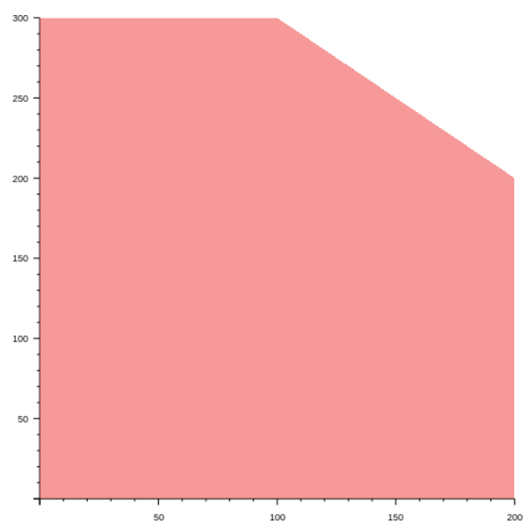
Key Idea Behind Simplex Algorithm
Simplex is a hill-climbing algorithm. Beginning at the start vertex, it moves to the neighboring vertex with a higher objective value until no more moves are possible.
1800
1900
Objective function:
Maximize x + 6y
1400
Constraints:
x ≥ 0
y ≥ 0
x ≤ 200
y ≤ 300
x+y ≤ 400
0
200

Slide 16
Types of Feasible Regions
Bounded. The optimum solution is at one of the vertices.
1800
1900
Objective function:
Maximize x + 6y
1400
Constraints:
x ≥ 0
y ≥ 0
x ≤ 200
y ≤ 300
x+y ≤ 400
0
200

Slide 17
Types of Feasible Regions
Infeasible. The feasible region is empty, so there is no solution
Objective function:
Maximize x + 6y
Constraints:
x ≥ 0
y ≥ 0
x ≤ -200
y ≤ -300

Slide 18
Types of Feasible Regions
Unbounded. The feasible region is infinite. There may or may not be an optimal solution. If there is one, it will be at a vertex. This one has no optimal solution.
Objective function:
Maximize x + 6y
Constraints:
x ≥ 0
y ≥ 0
x ≤ 200
0
200

Slide 19
Types of Feasible Regions
Unbounded. This unbounded one does have a solution.
Objective function:
Minimize + 6y
Constraints:
x ≥ 0
y ≥ 0
x ≤ 200
0
200

